Slide 1
1980s Iowa Underground Rock
Justin Baumgartner
Heidi Stofer

Slide 2
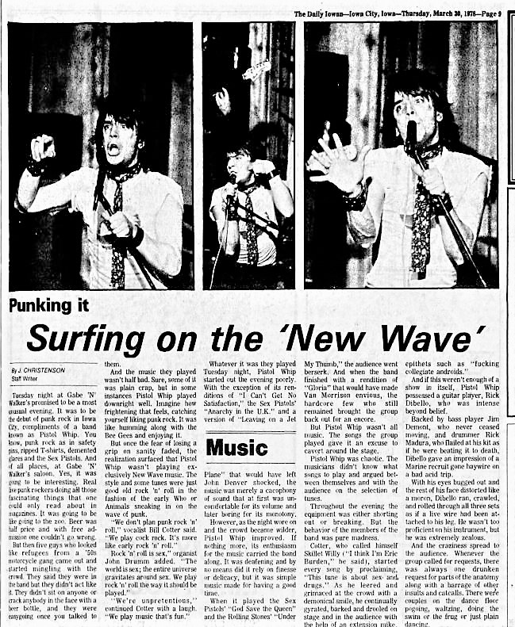
Punk rock comes to Iowa City
Daily Iowan, March 30, 1978

Slide 3
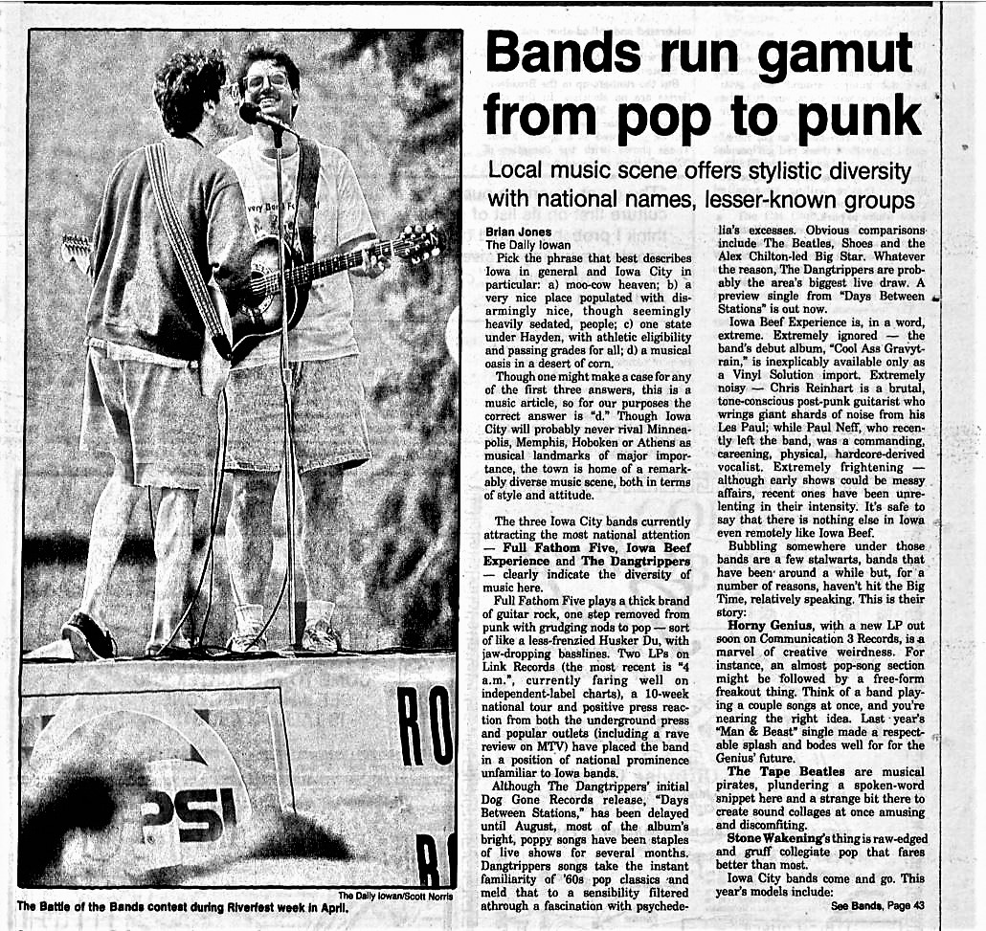
Daily Iowan, August 22, 1989

Slide 4
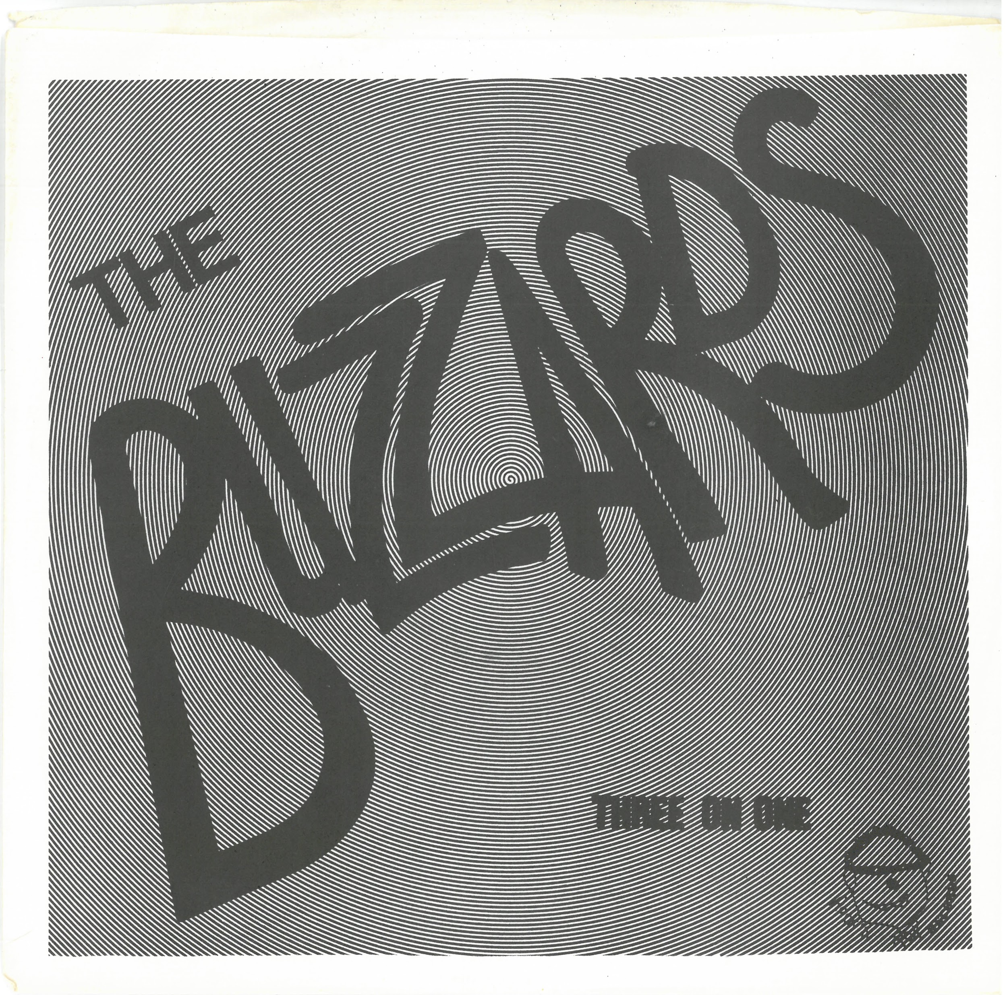
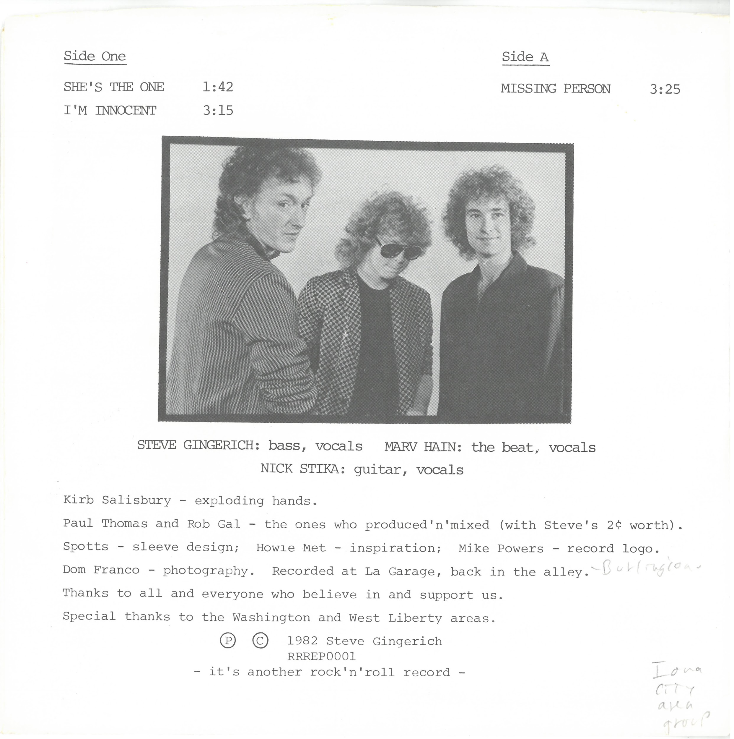
The Buzzards (1982)
“She’s the One” music video

Slide 5
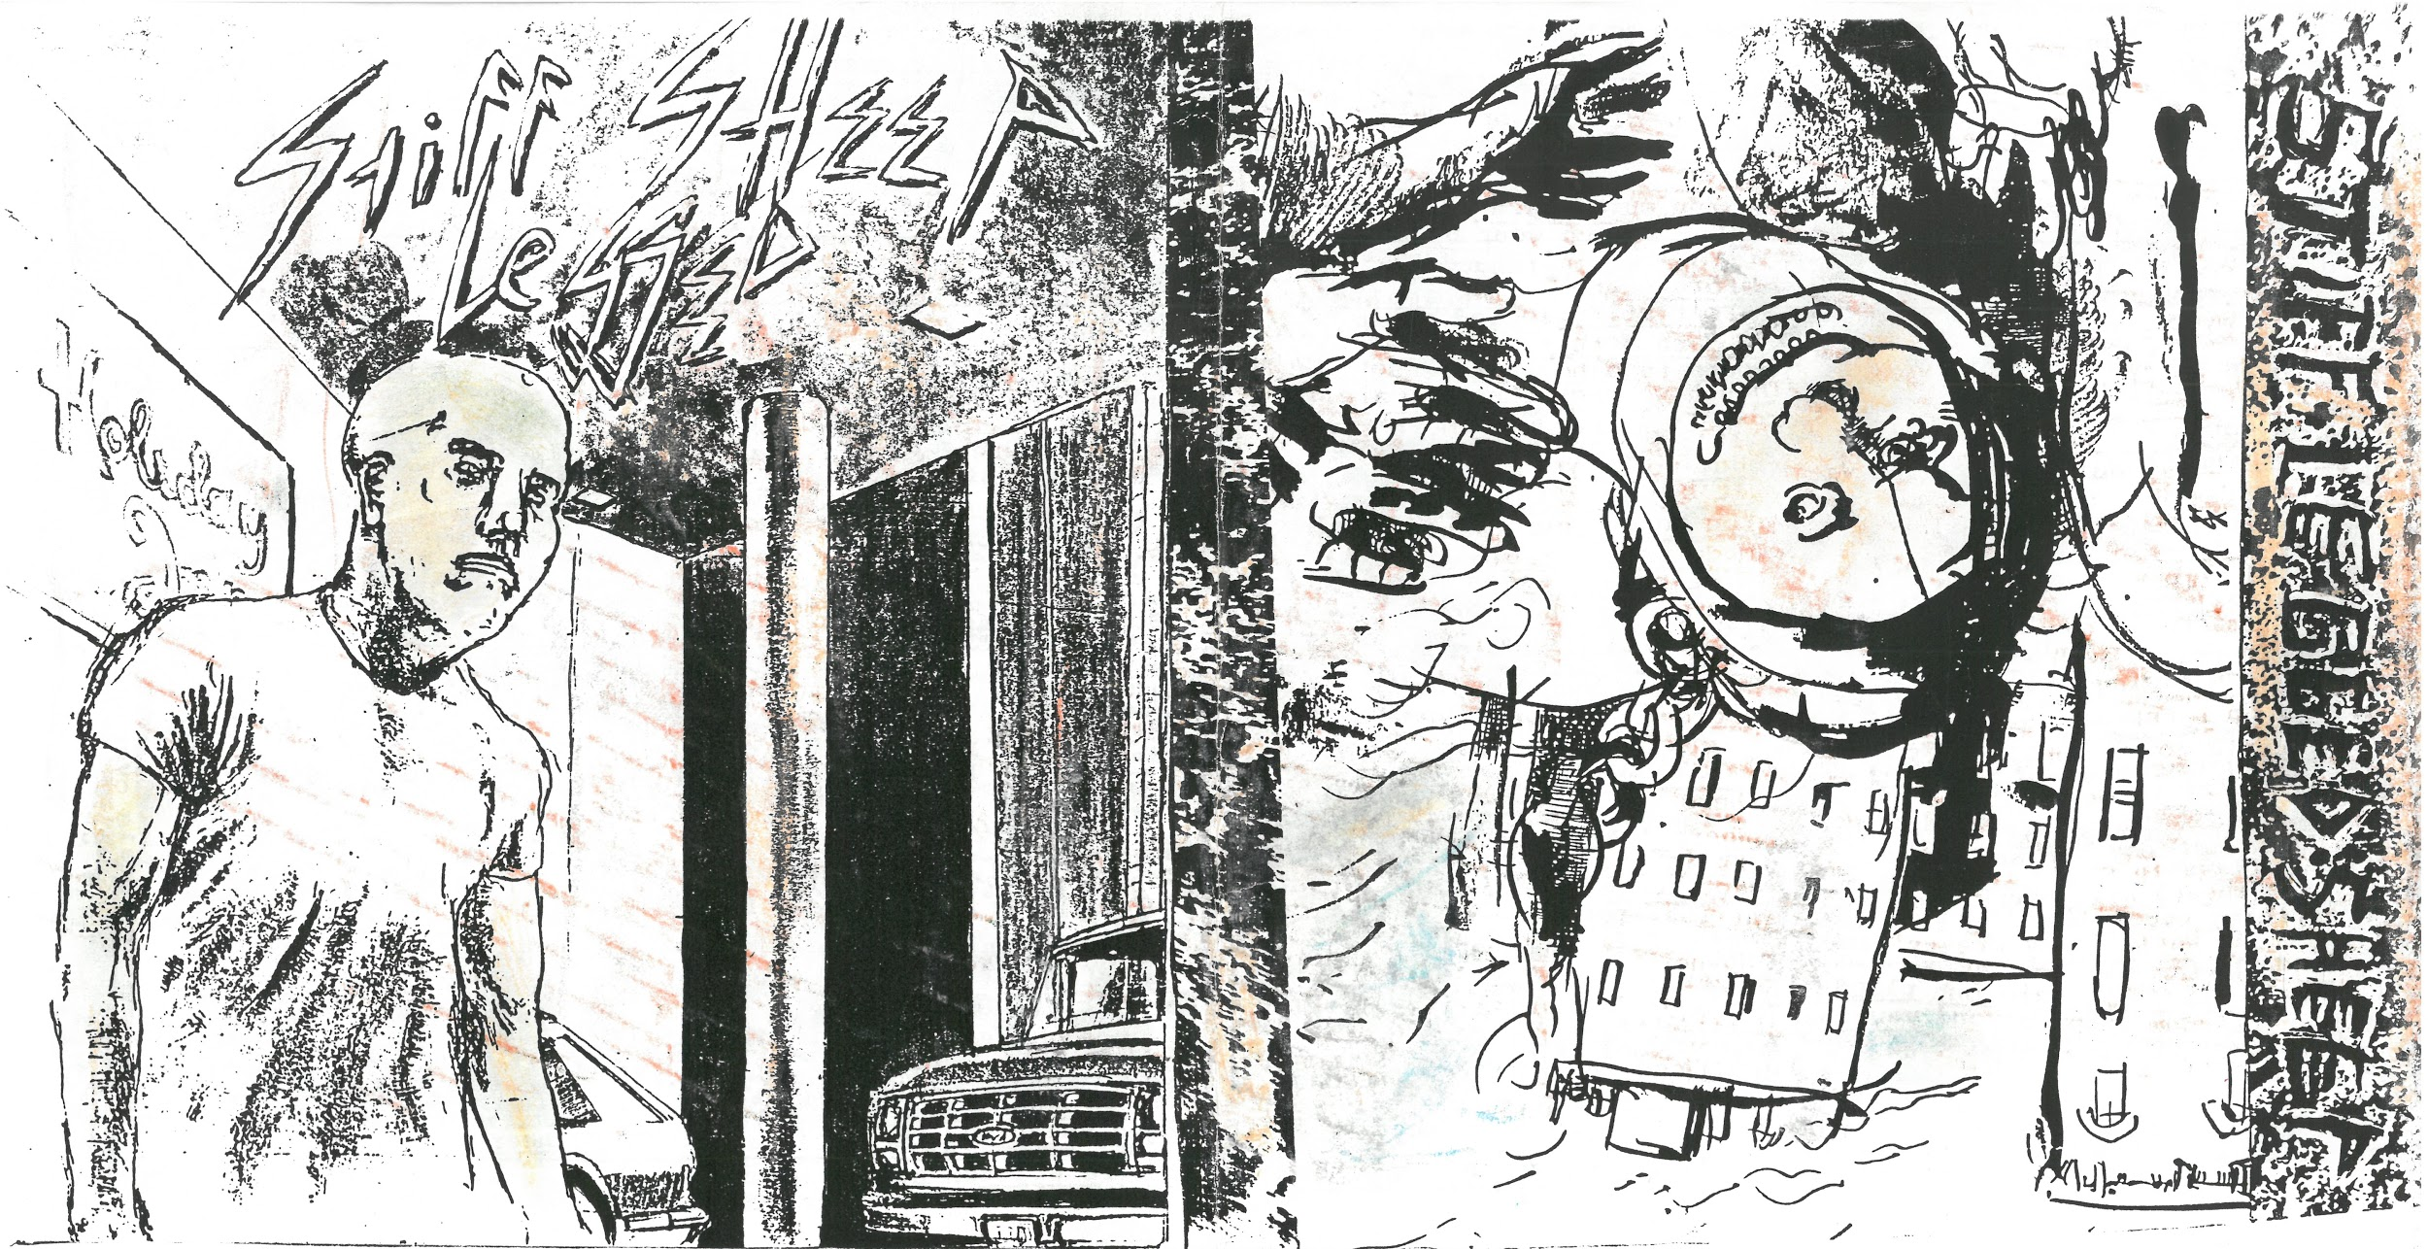
Stiff Legged Sheep (1985)

Slide 6
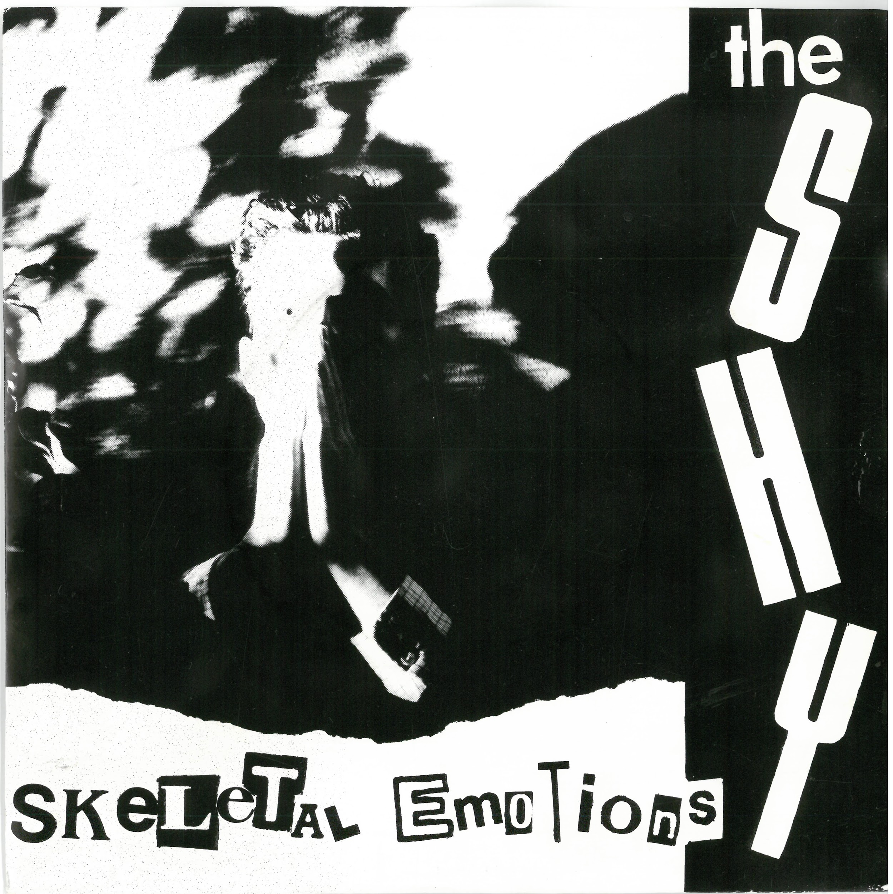
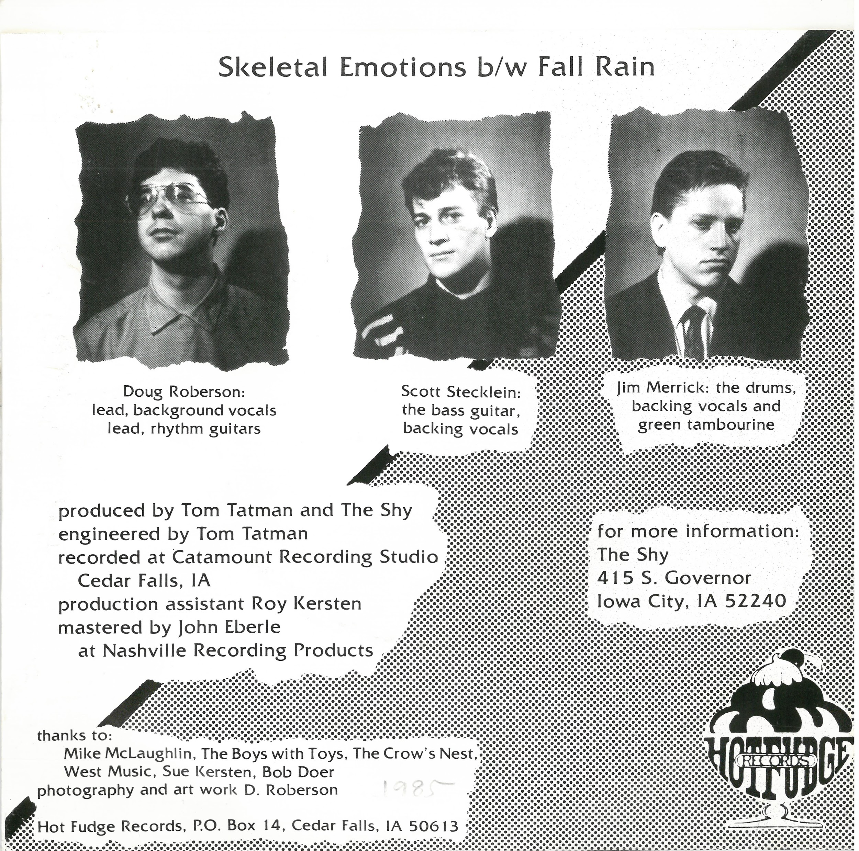
The Shy (1985)
“Skeletal Emotions” music video

Slide 7
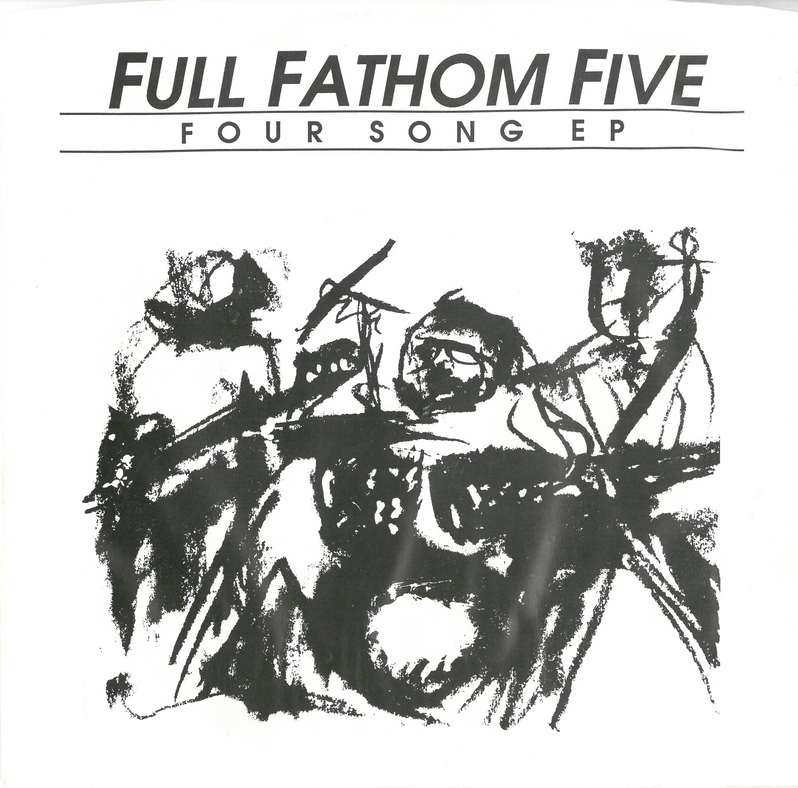
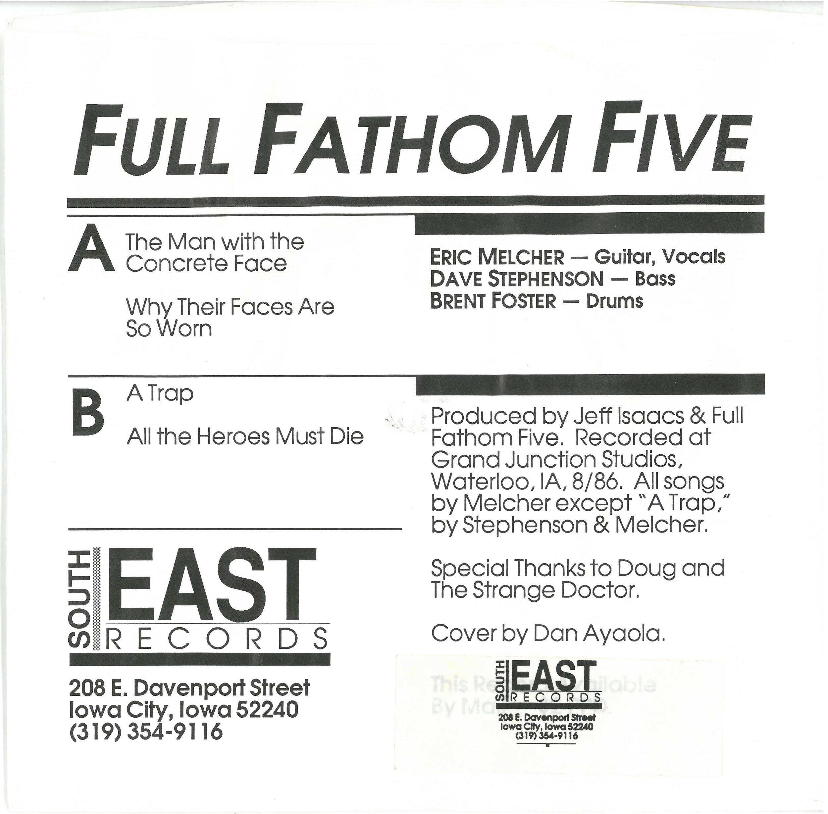
Full Fathom Five (1986)

Slide 8
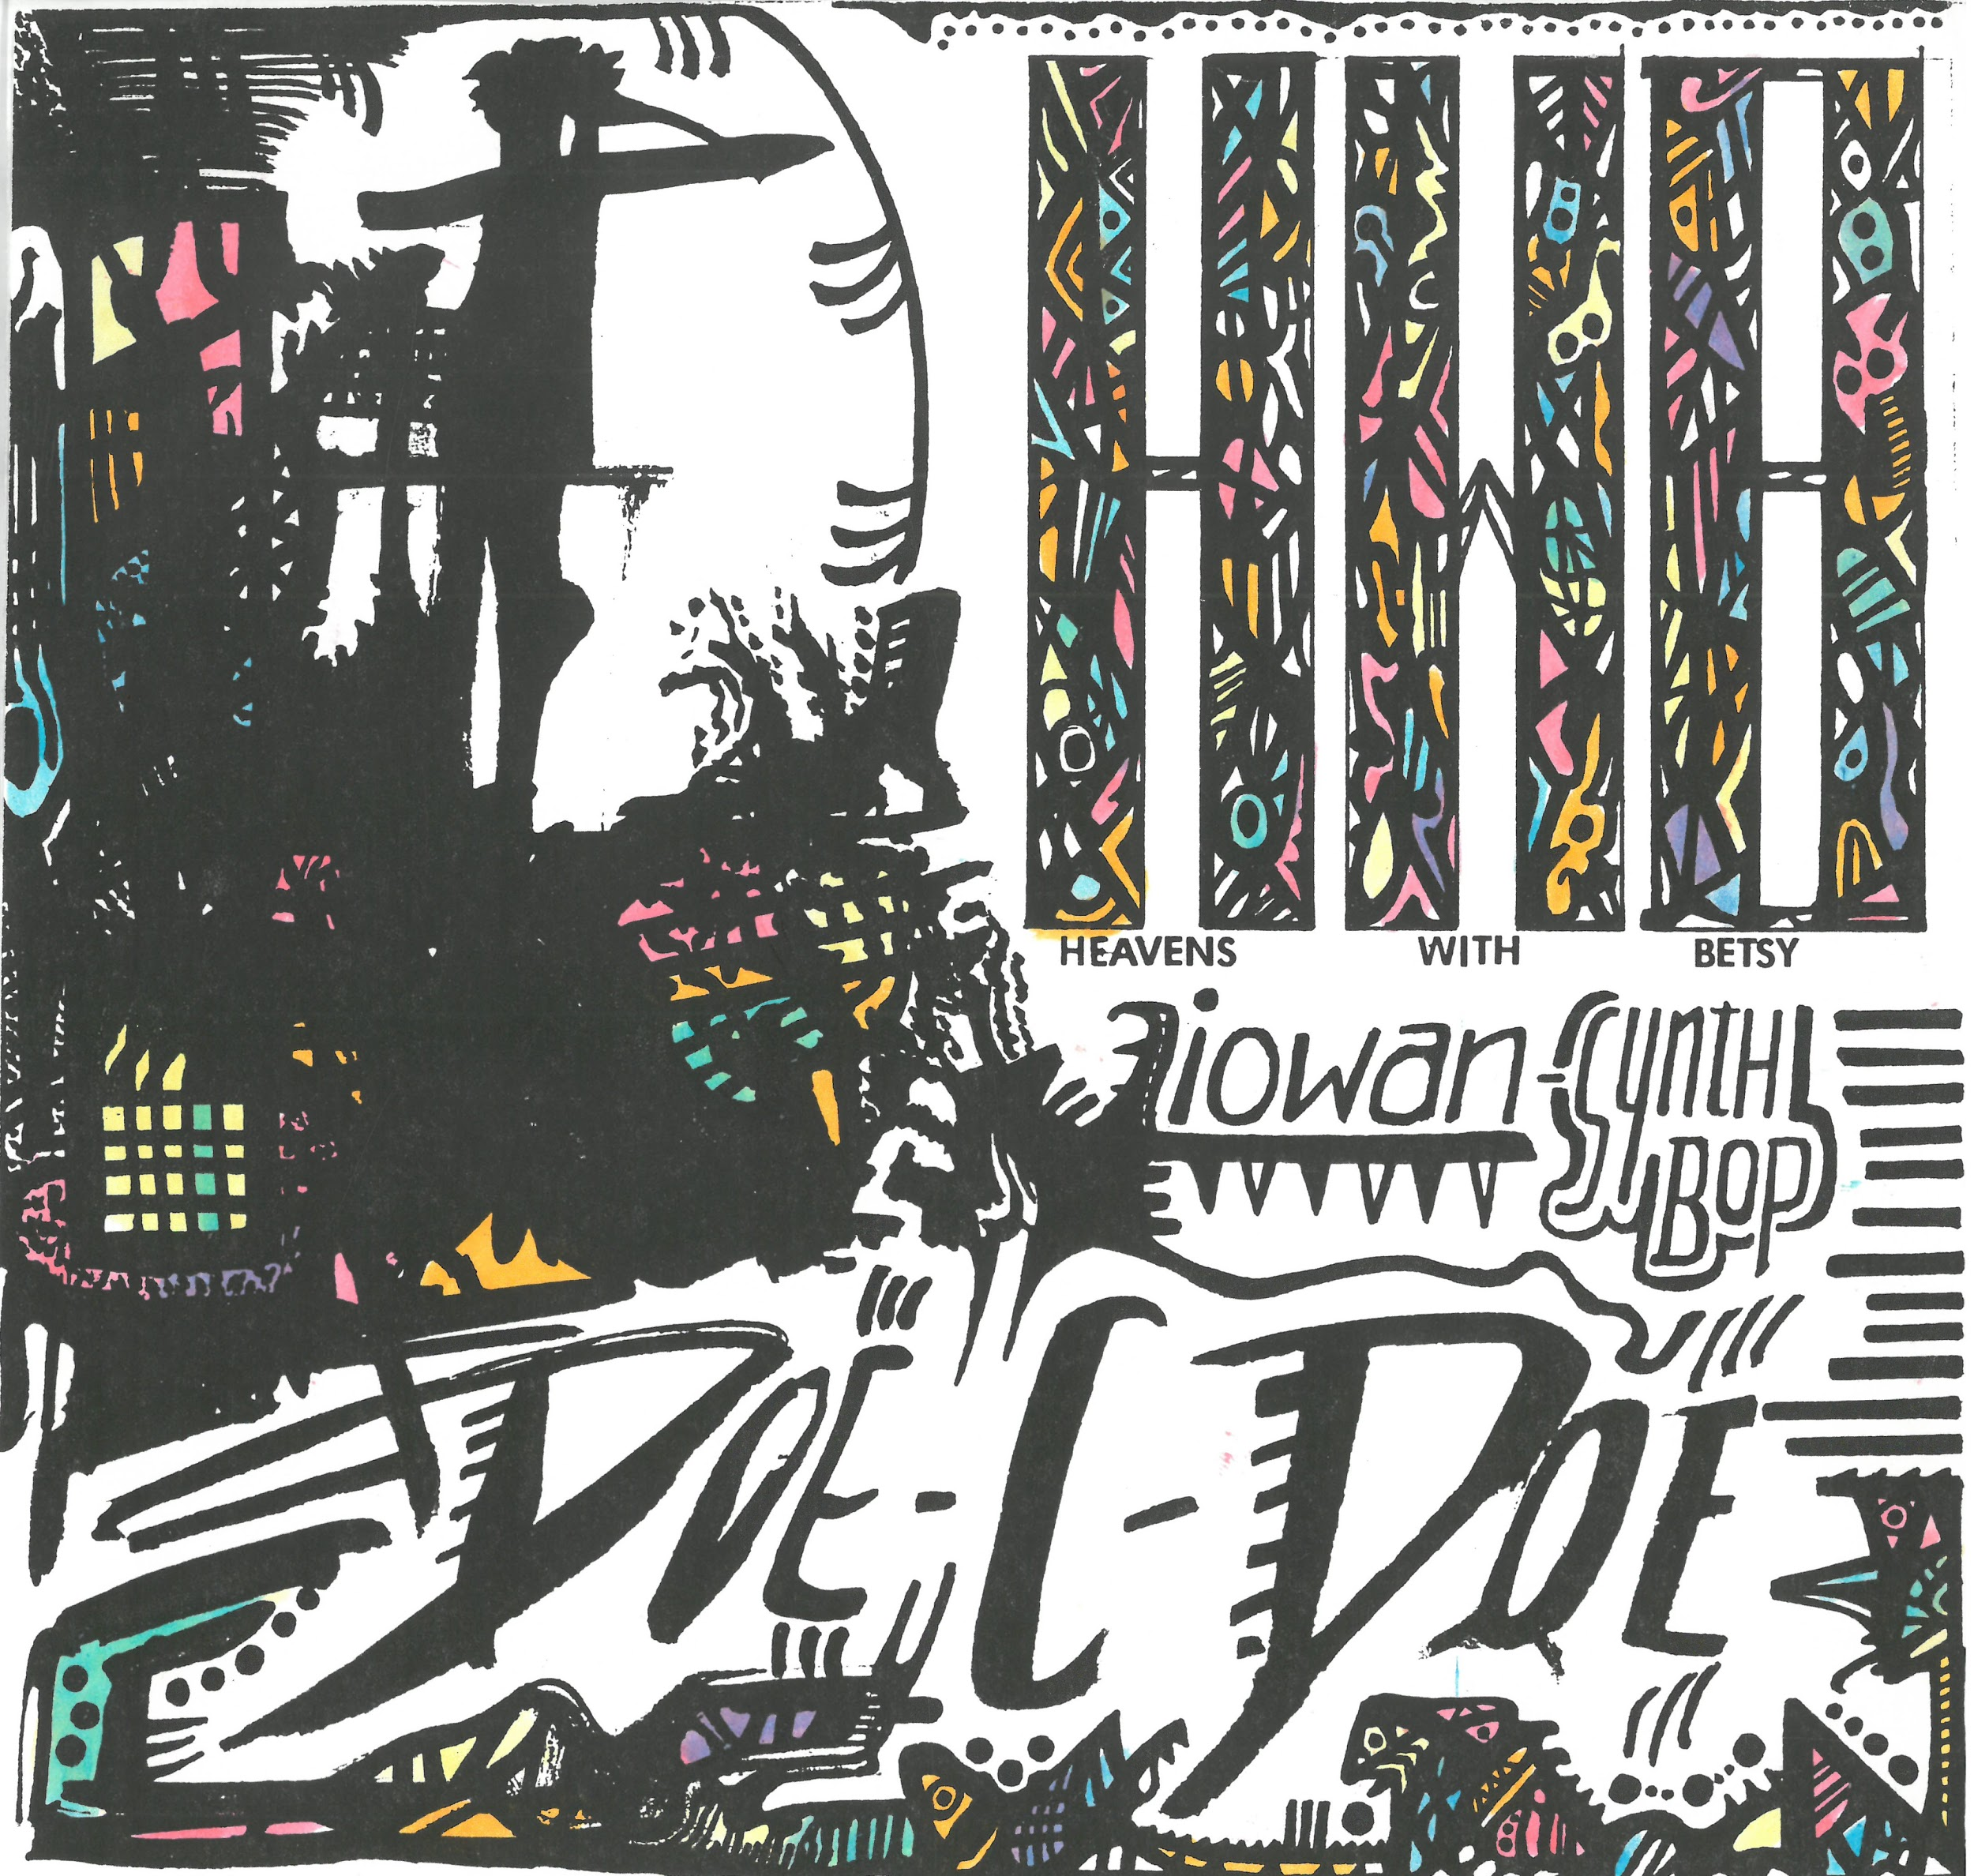
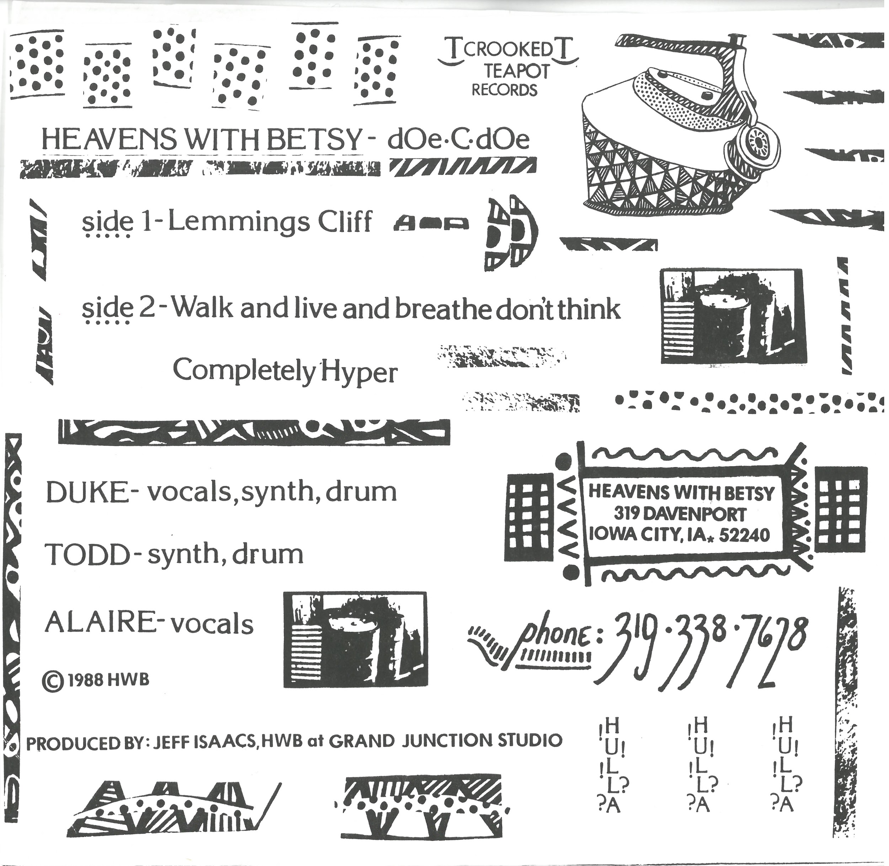
Heavens With Betsy (1988)

Slide 9
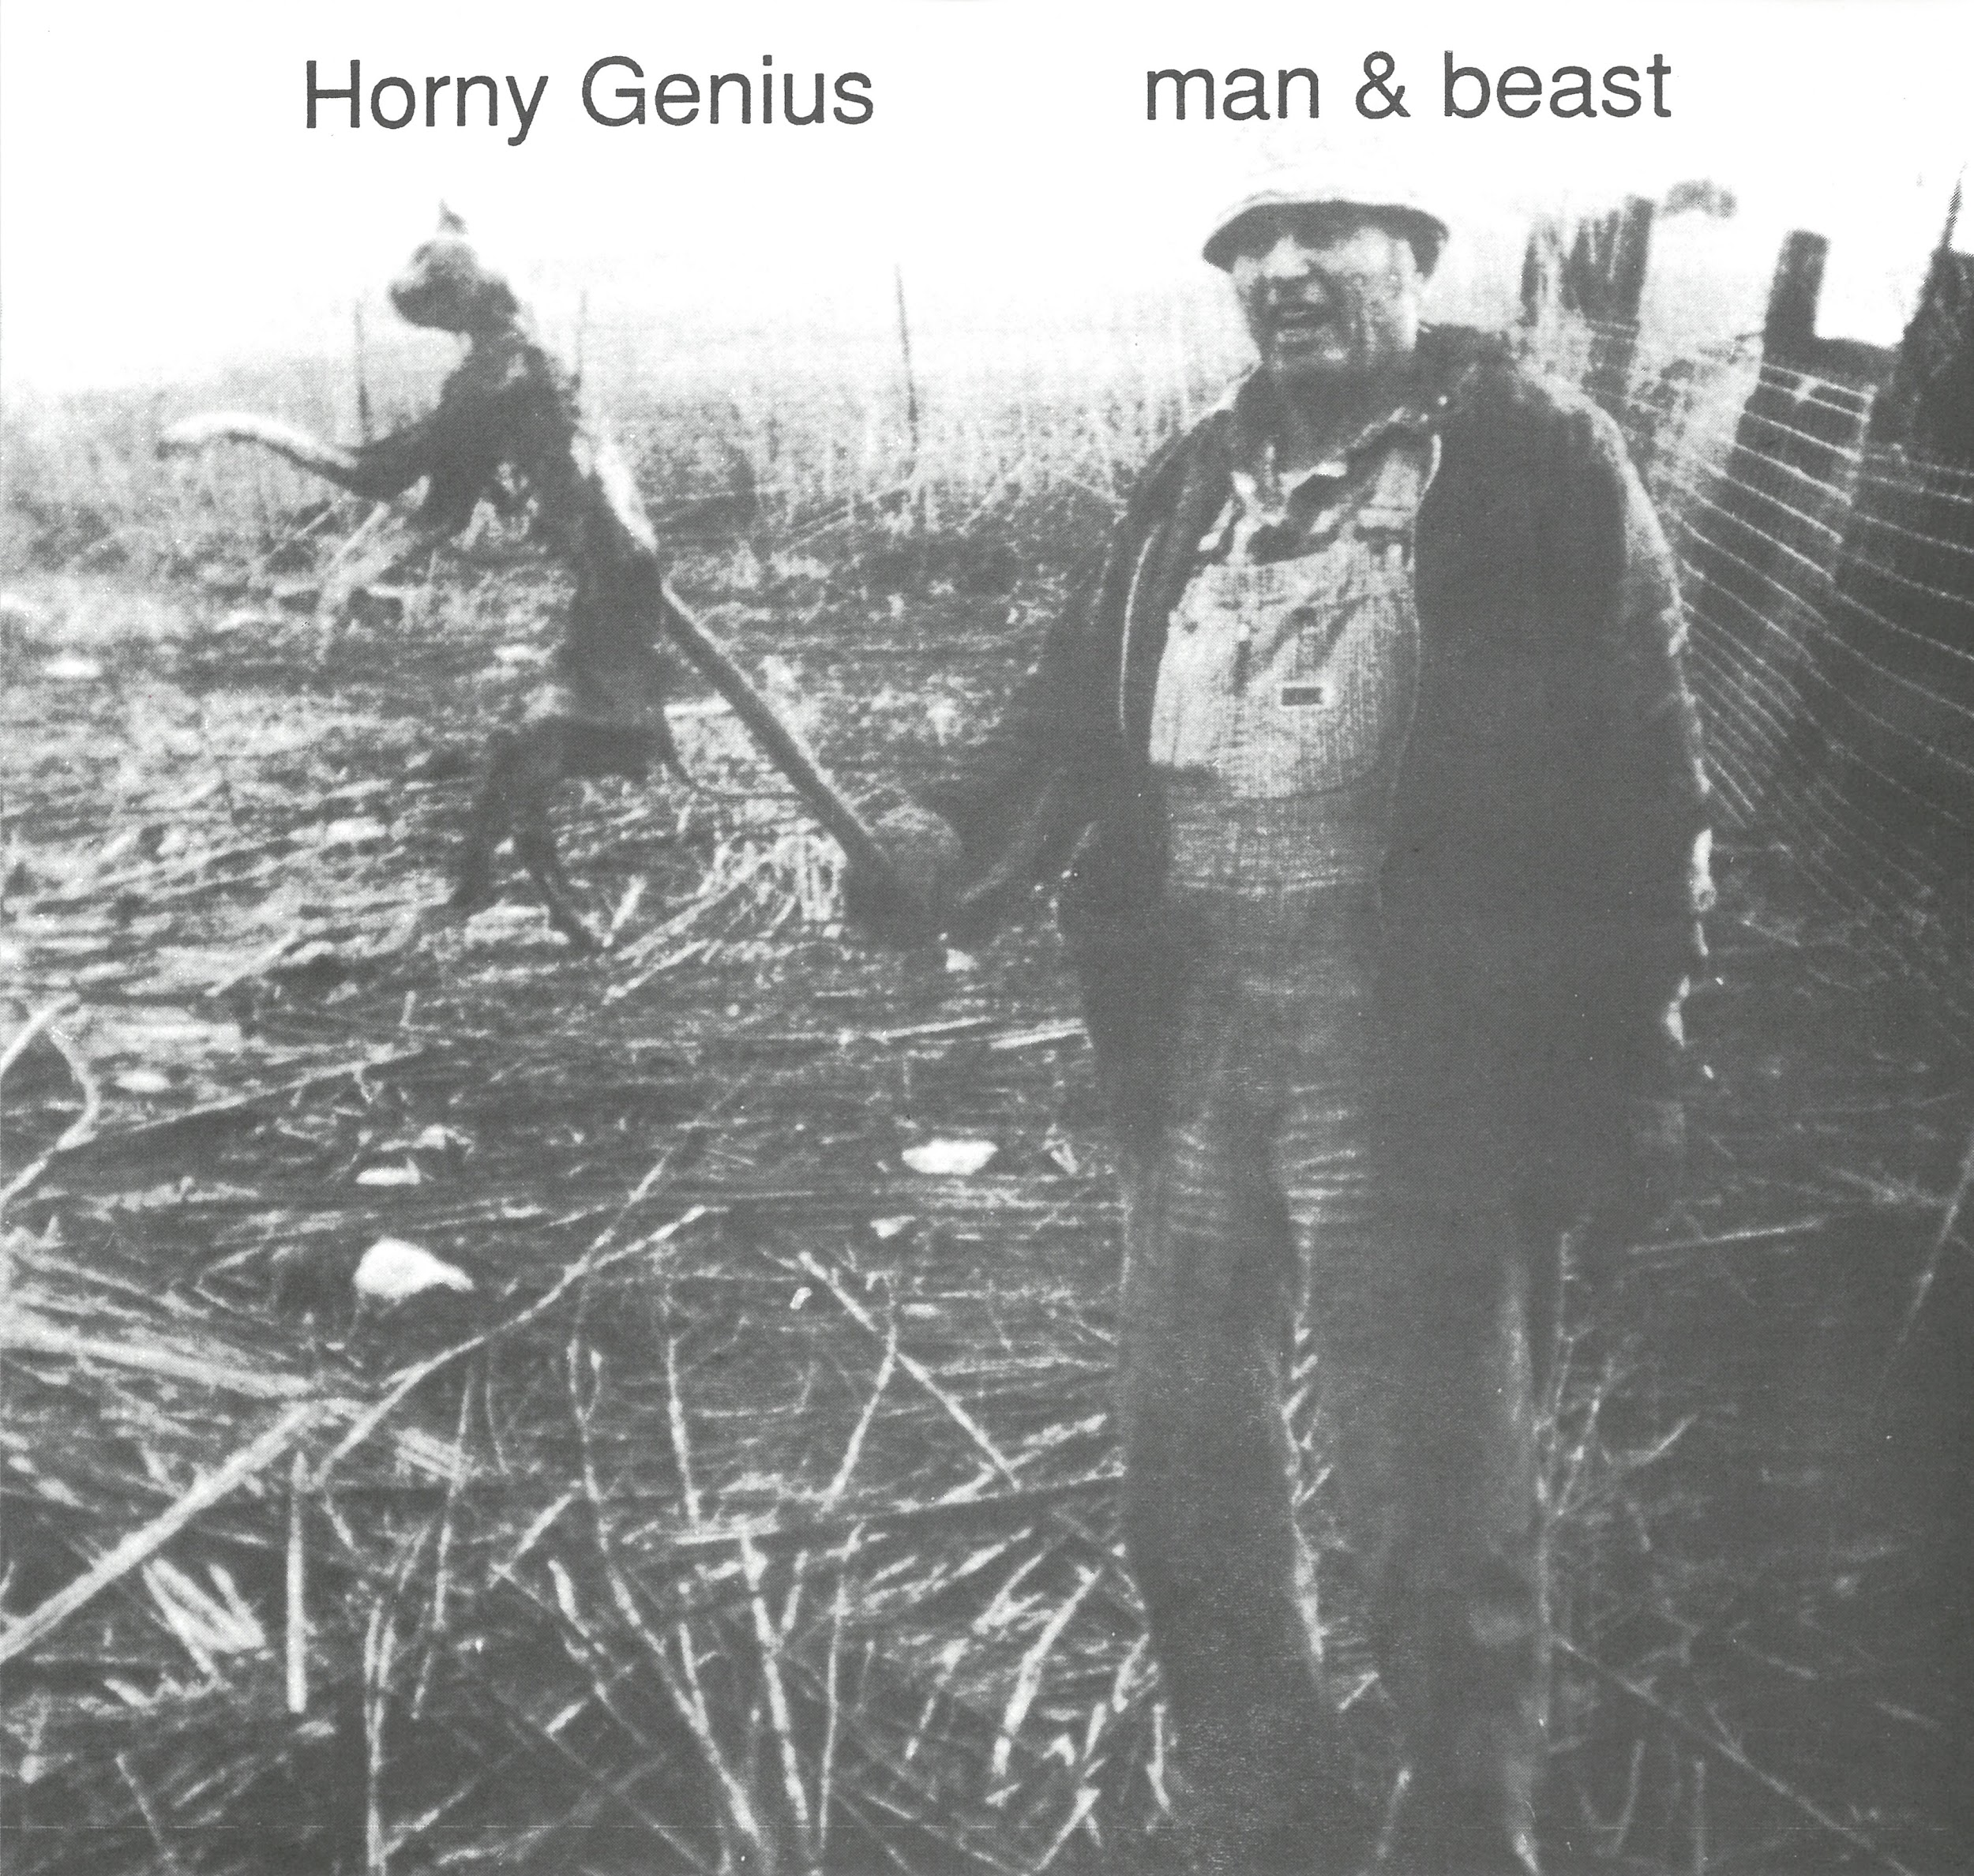
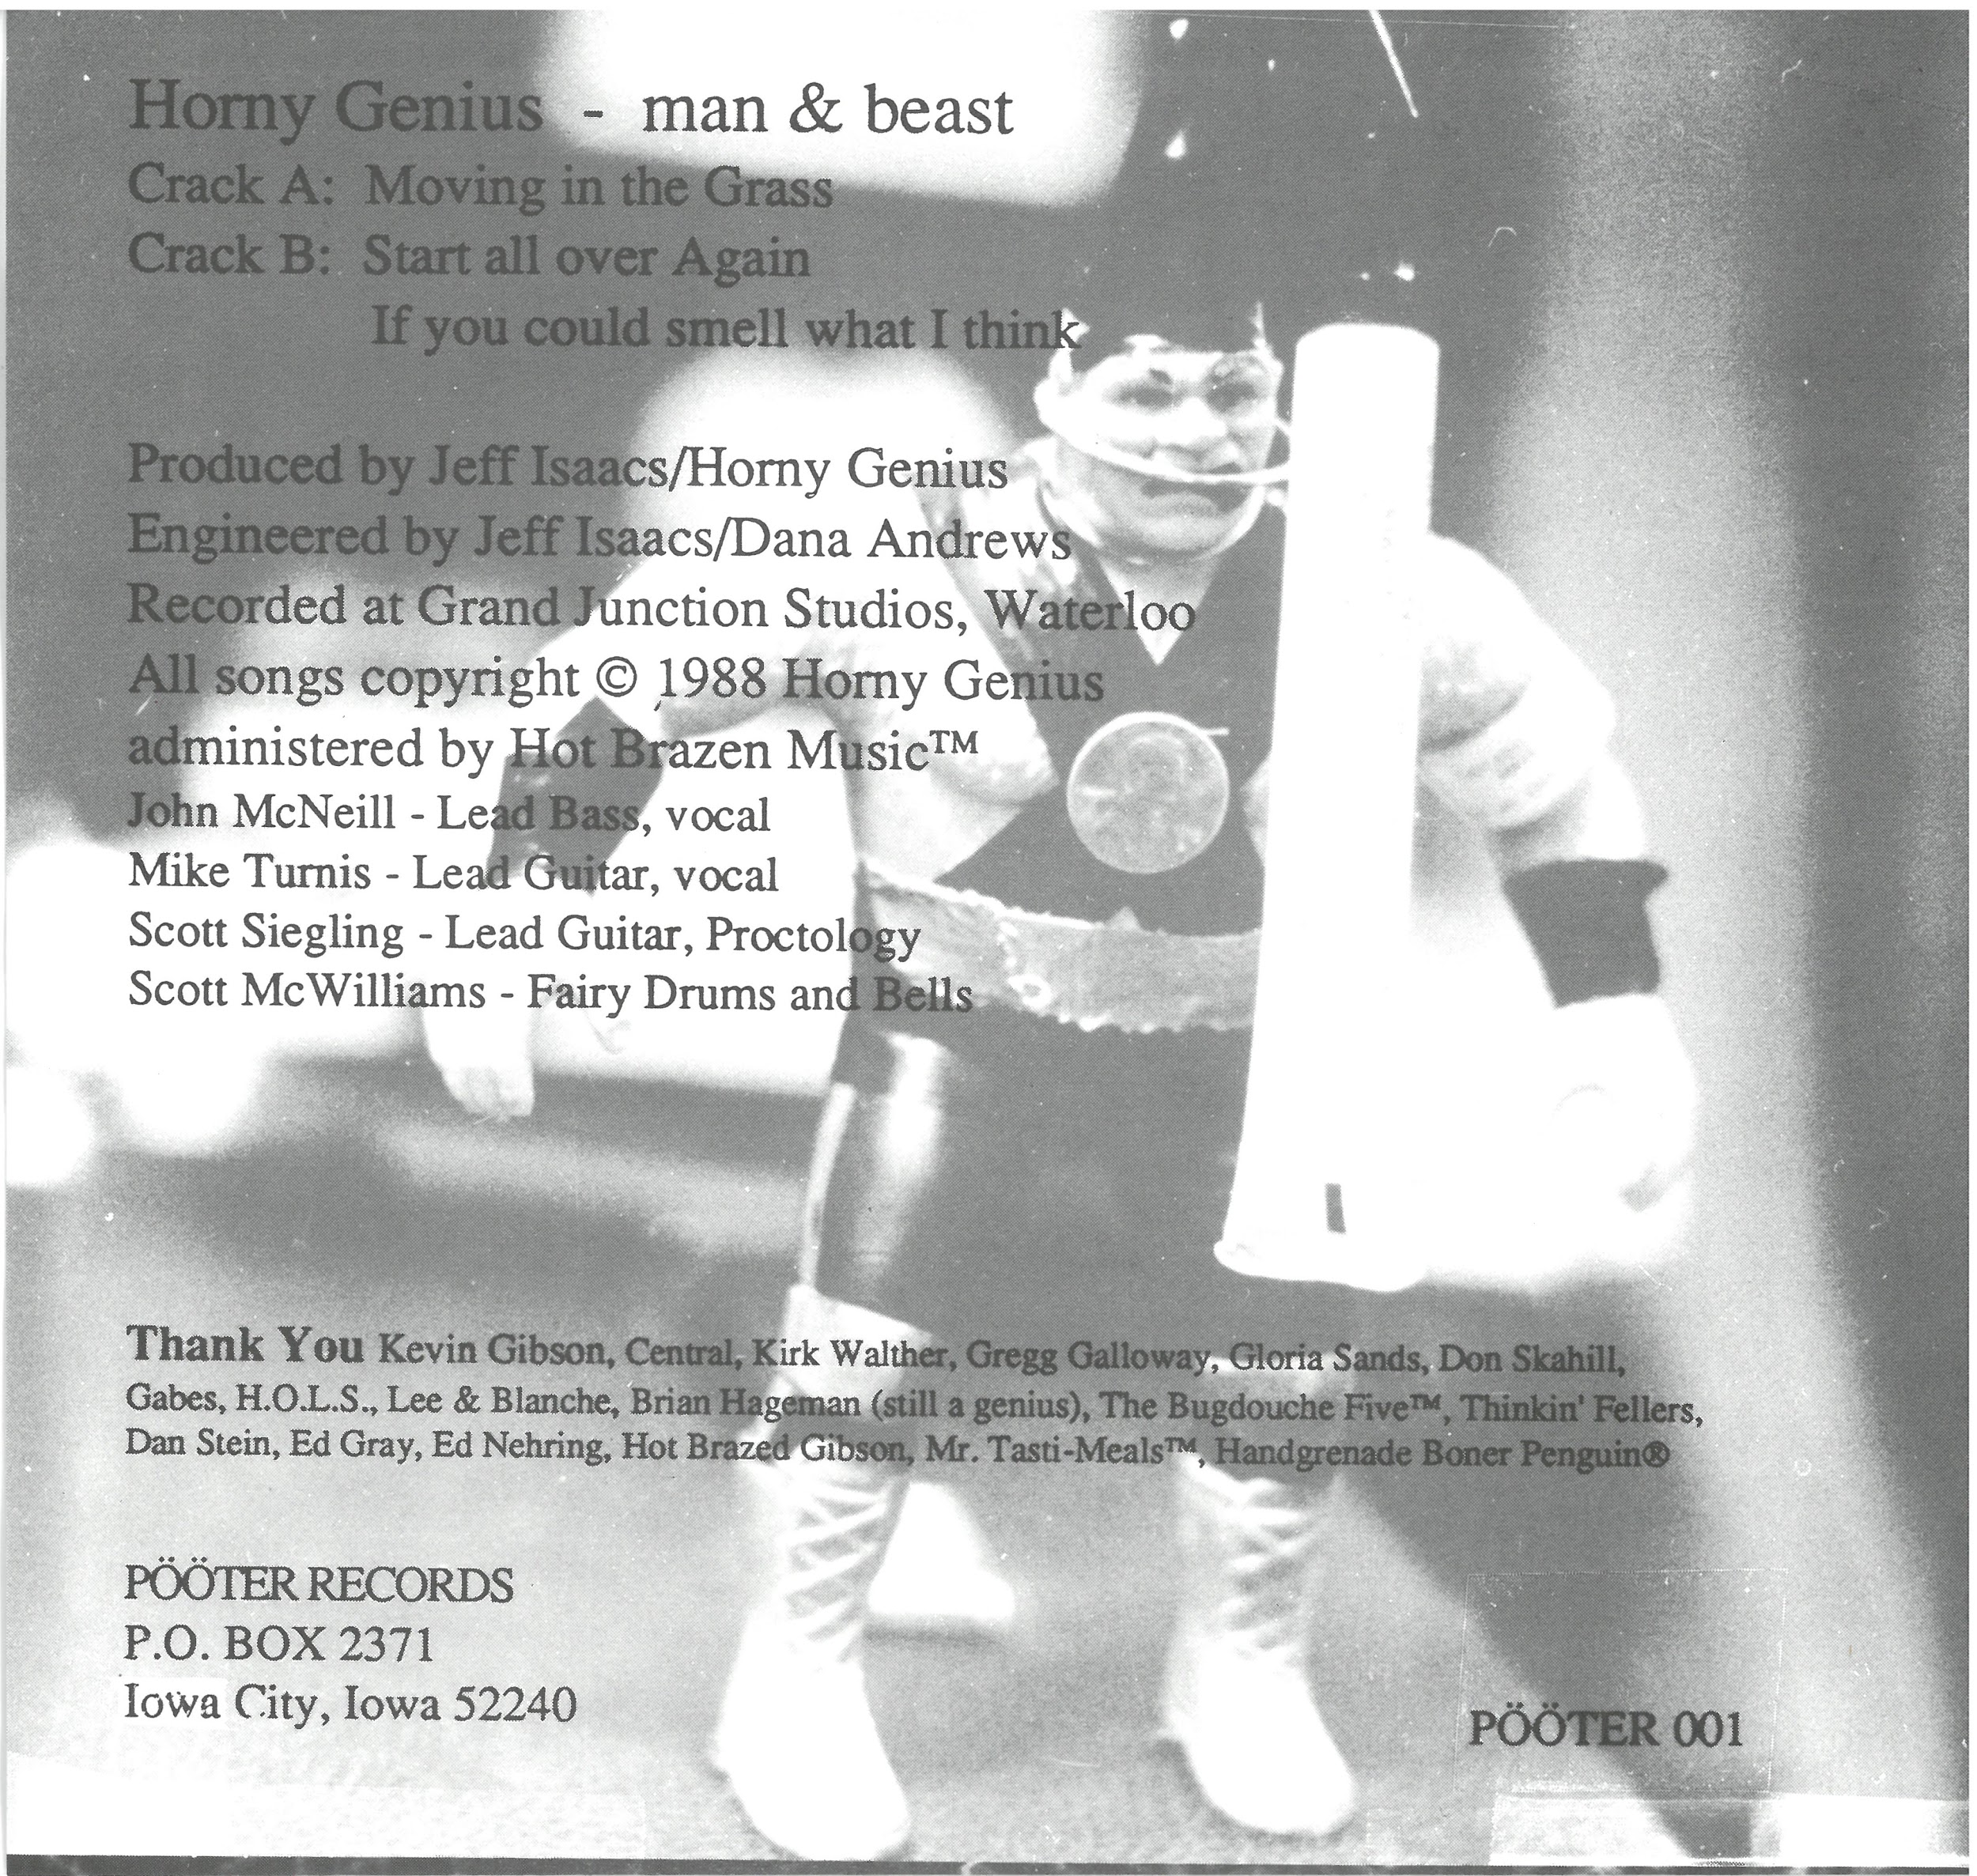
Horny Genius (1988)

Slide 10
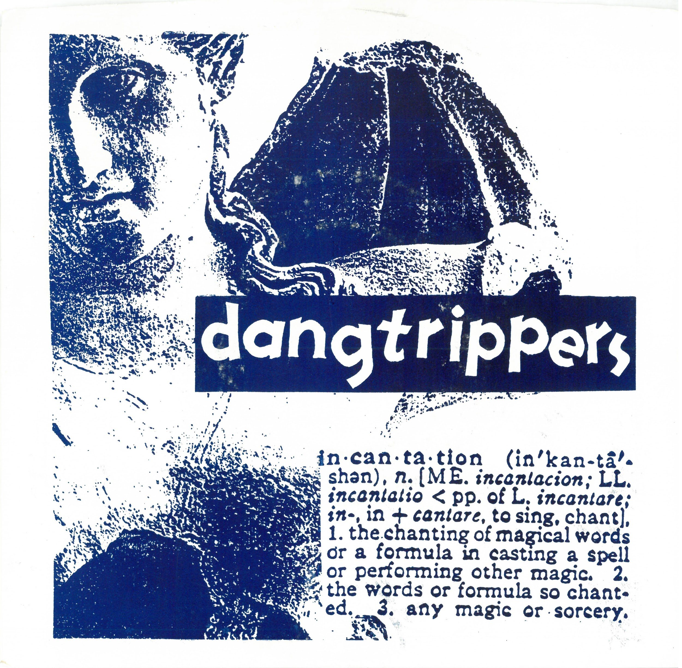
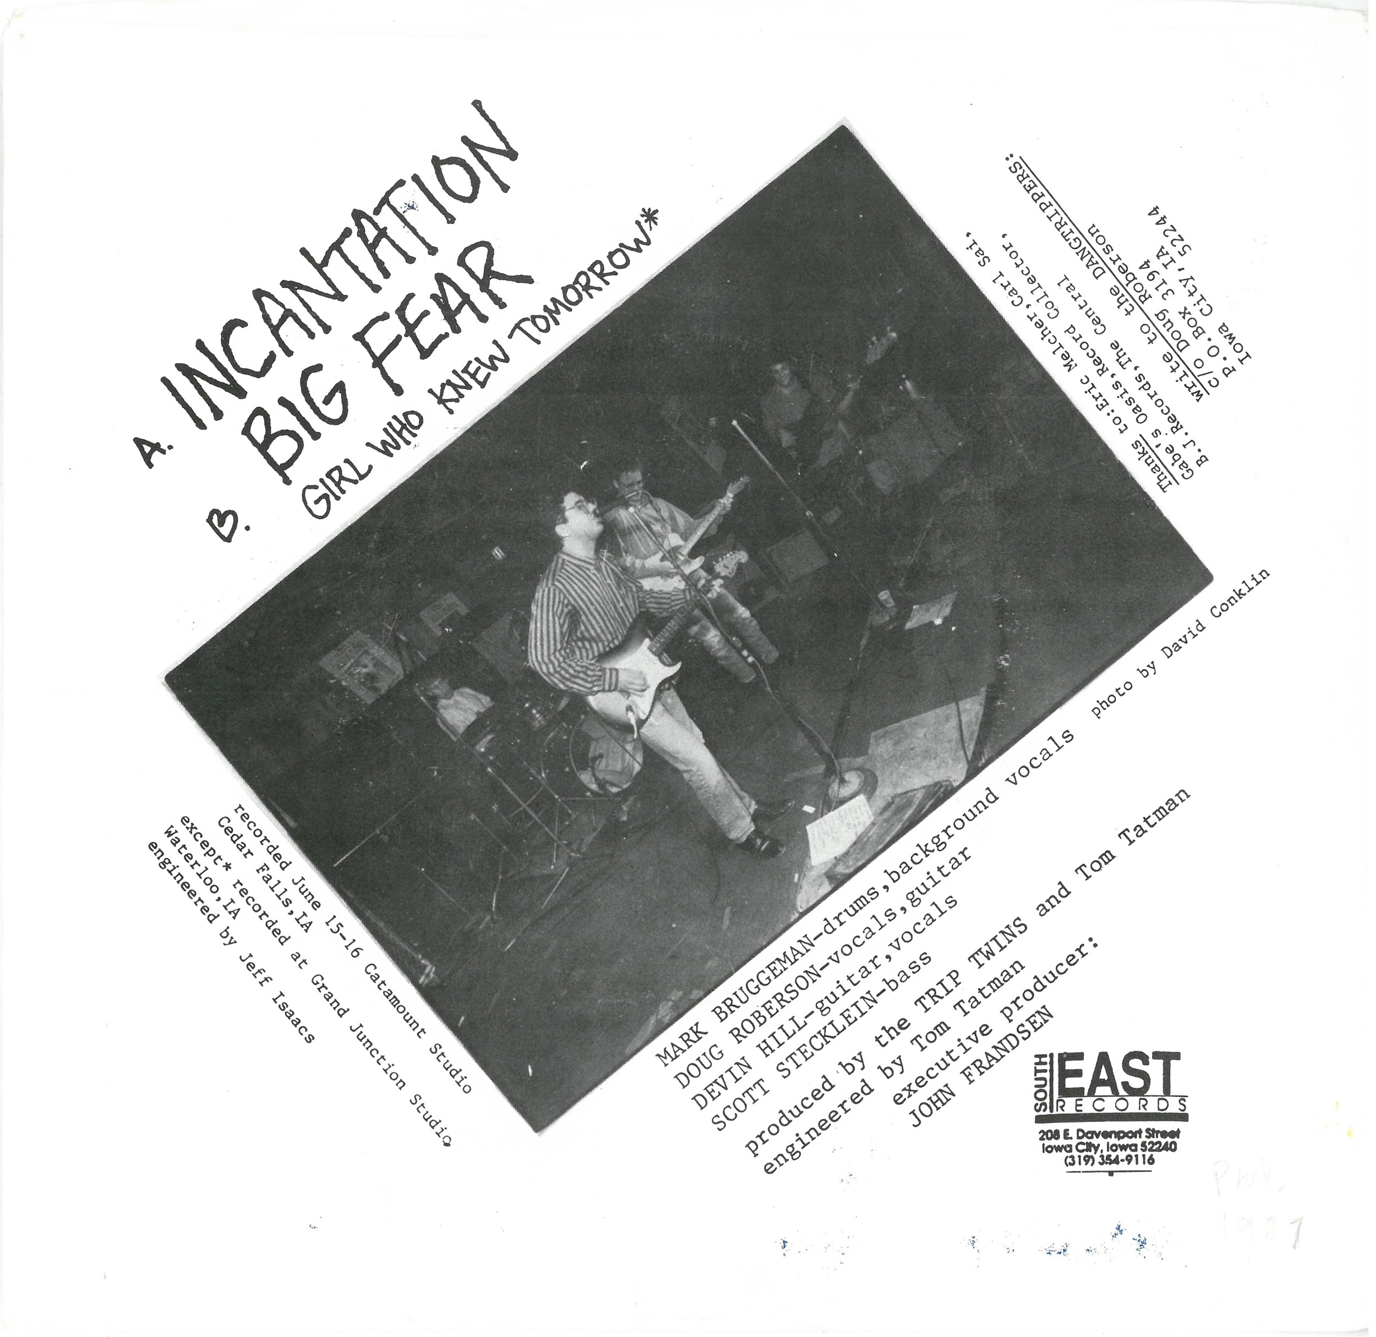
Dangtrippers (1987)

Slide 11
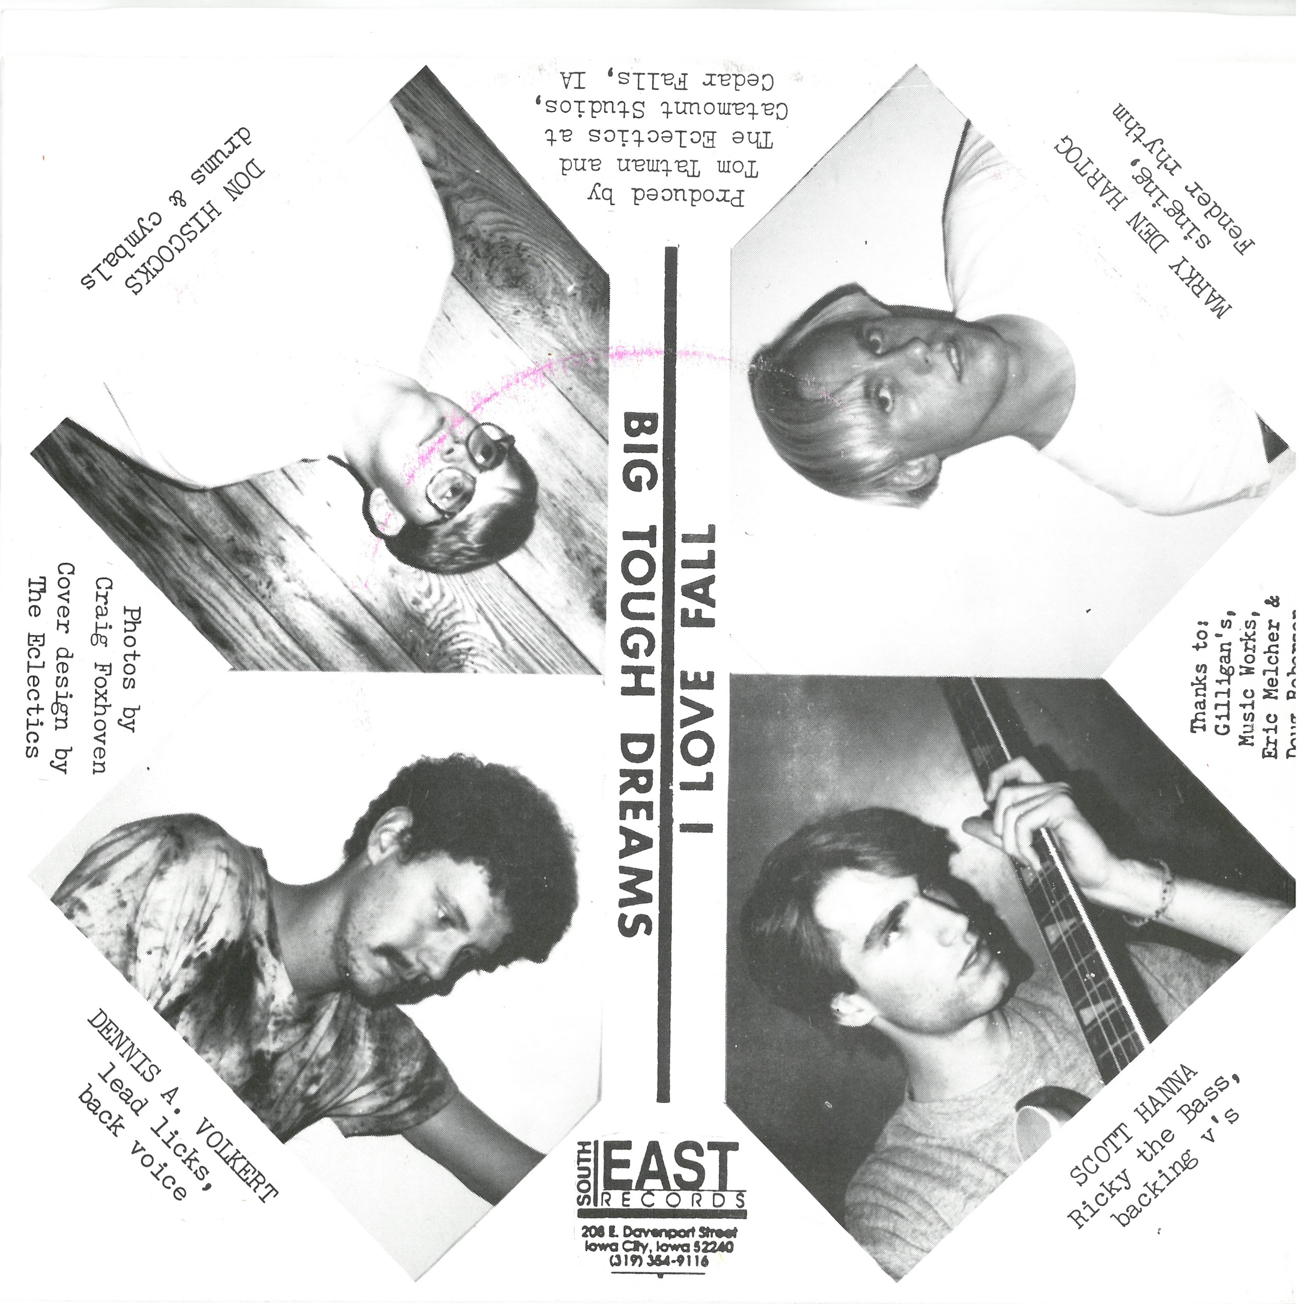
The Eclectics (1987)

Slide 12
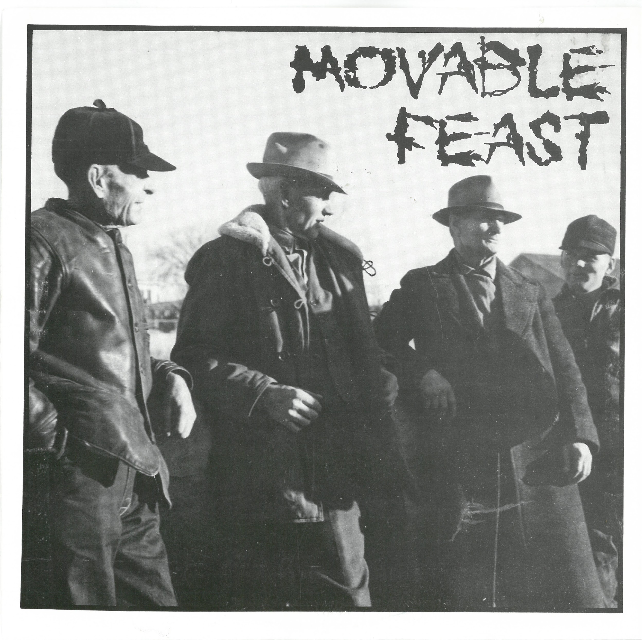
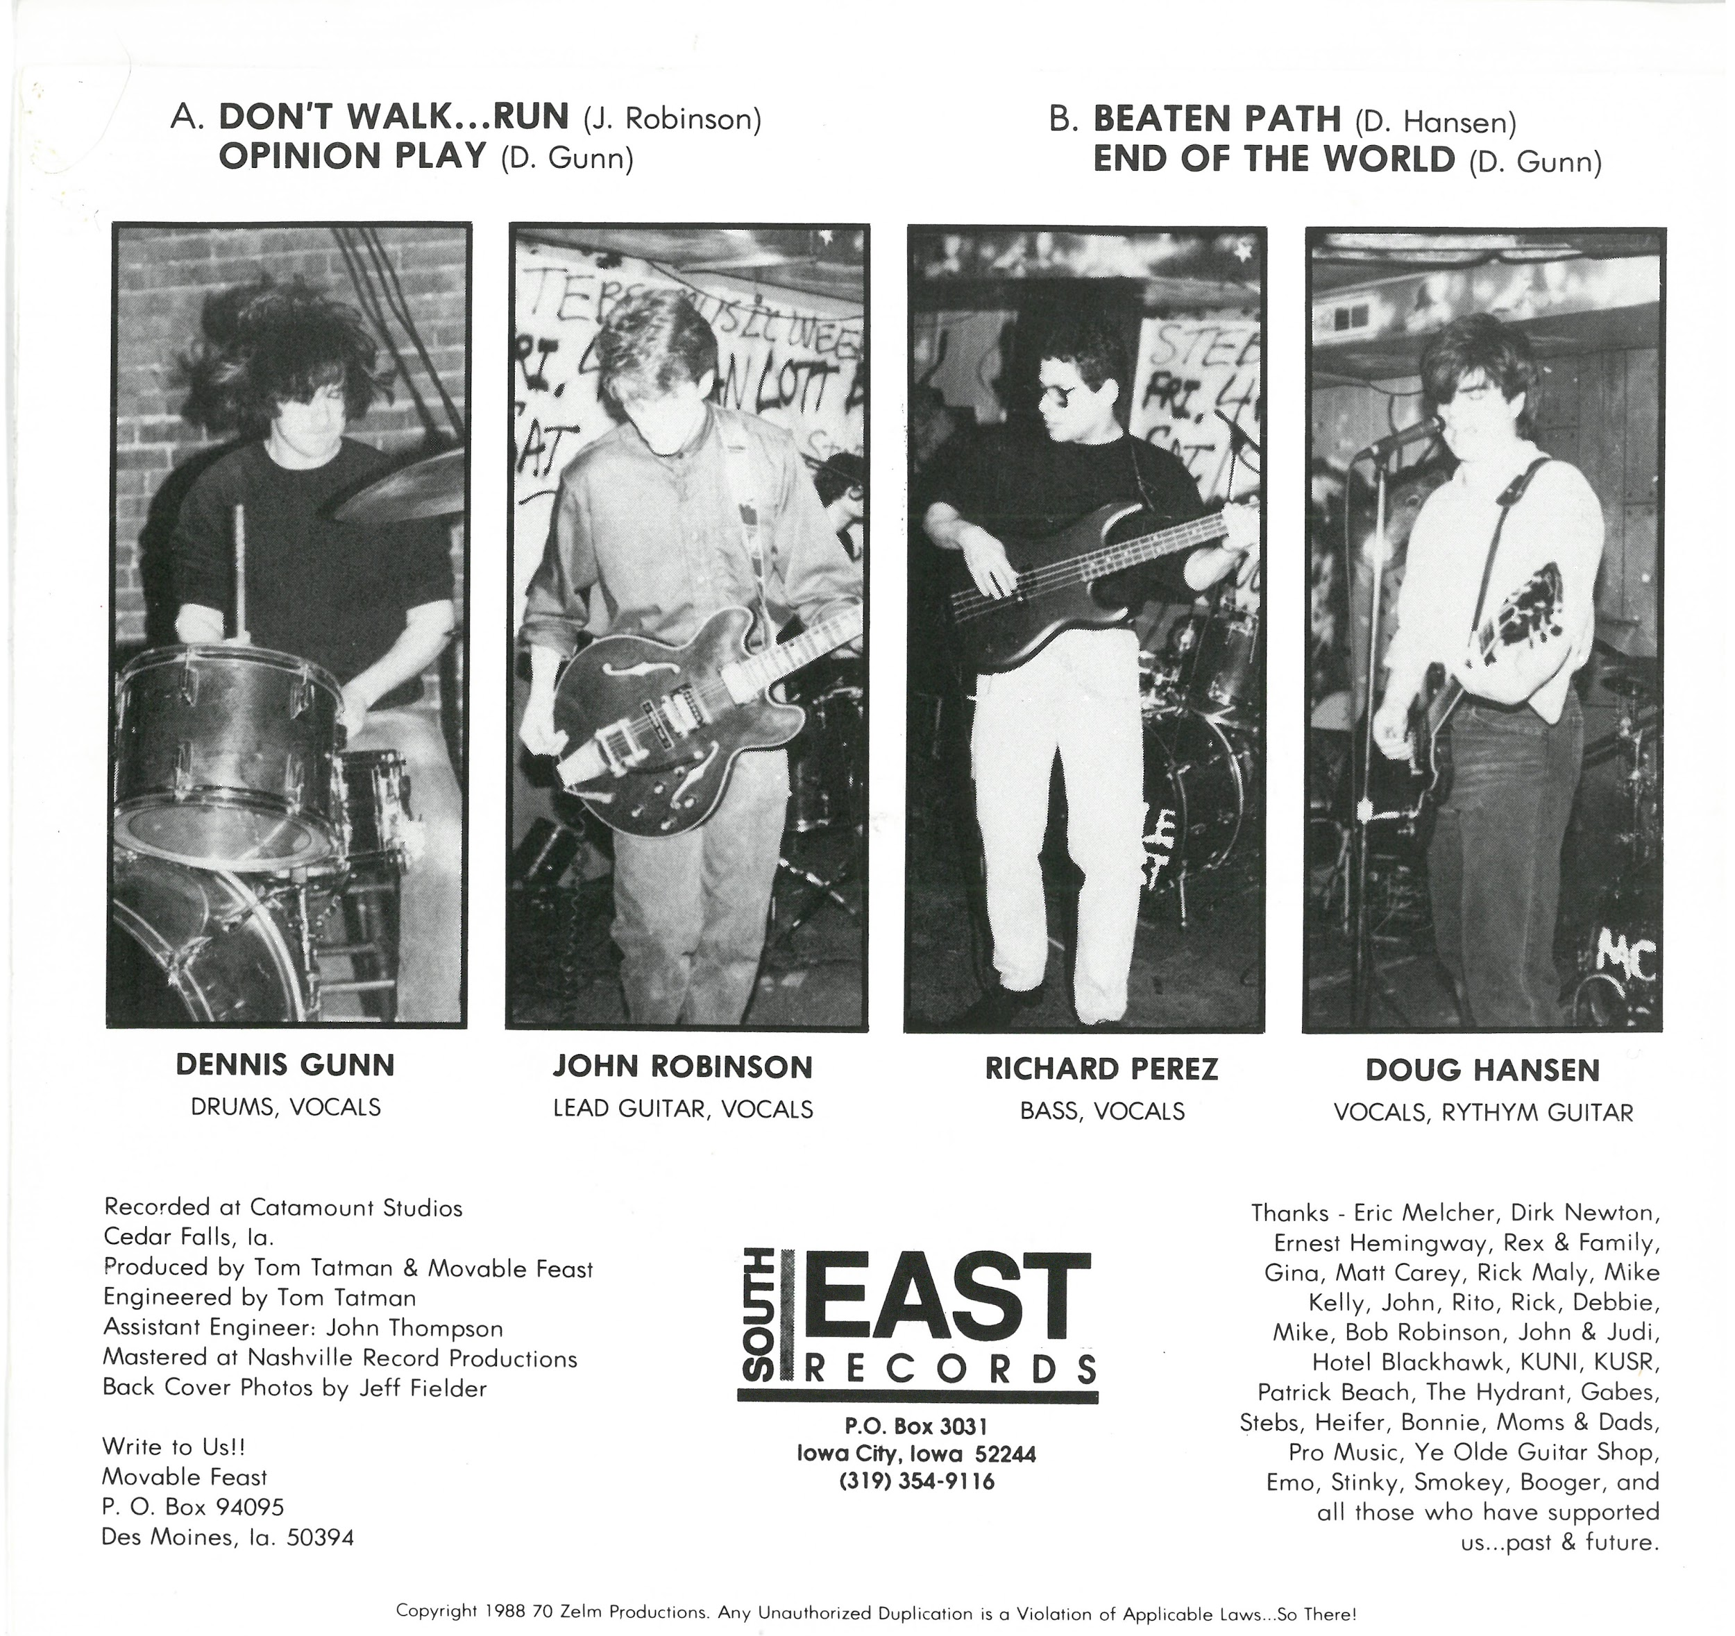
Movable Feast (1988)

Slide 13
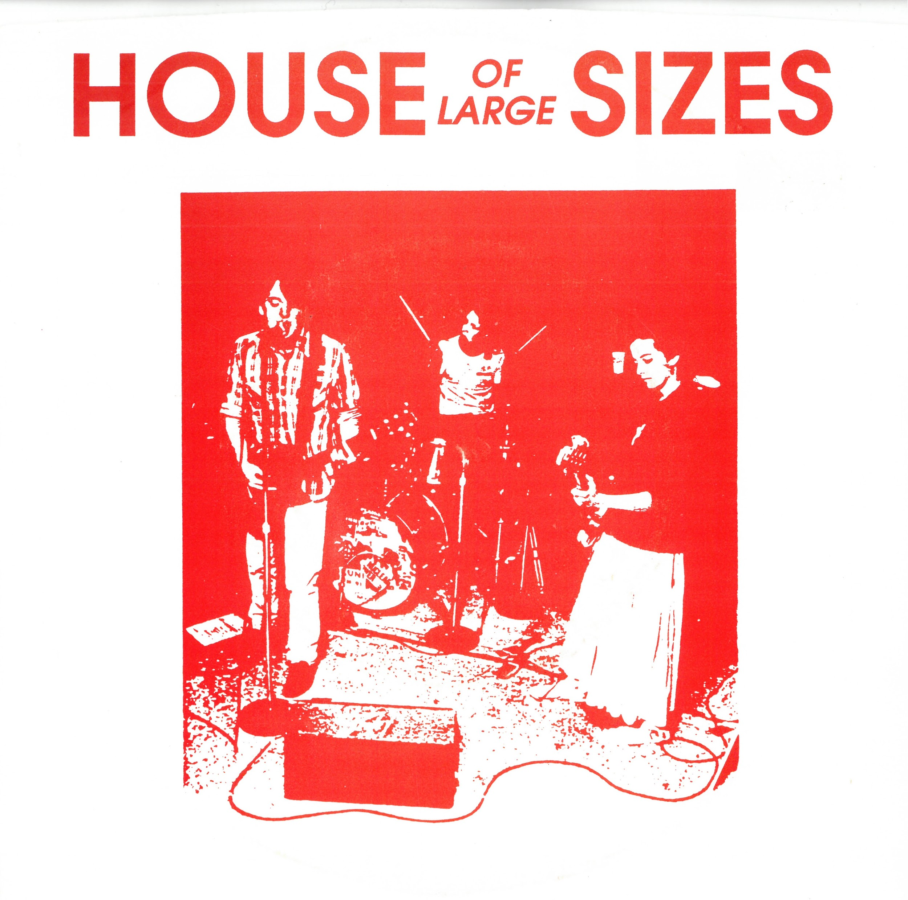
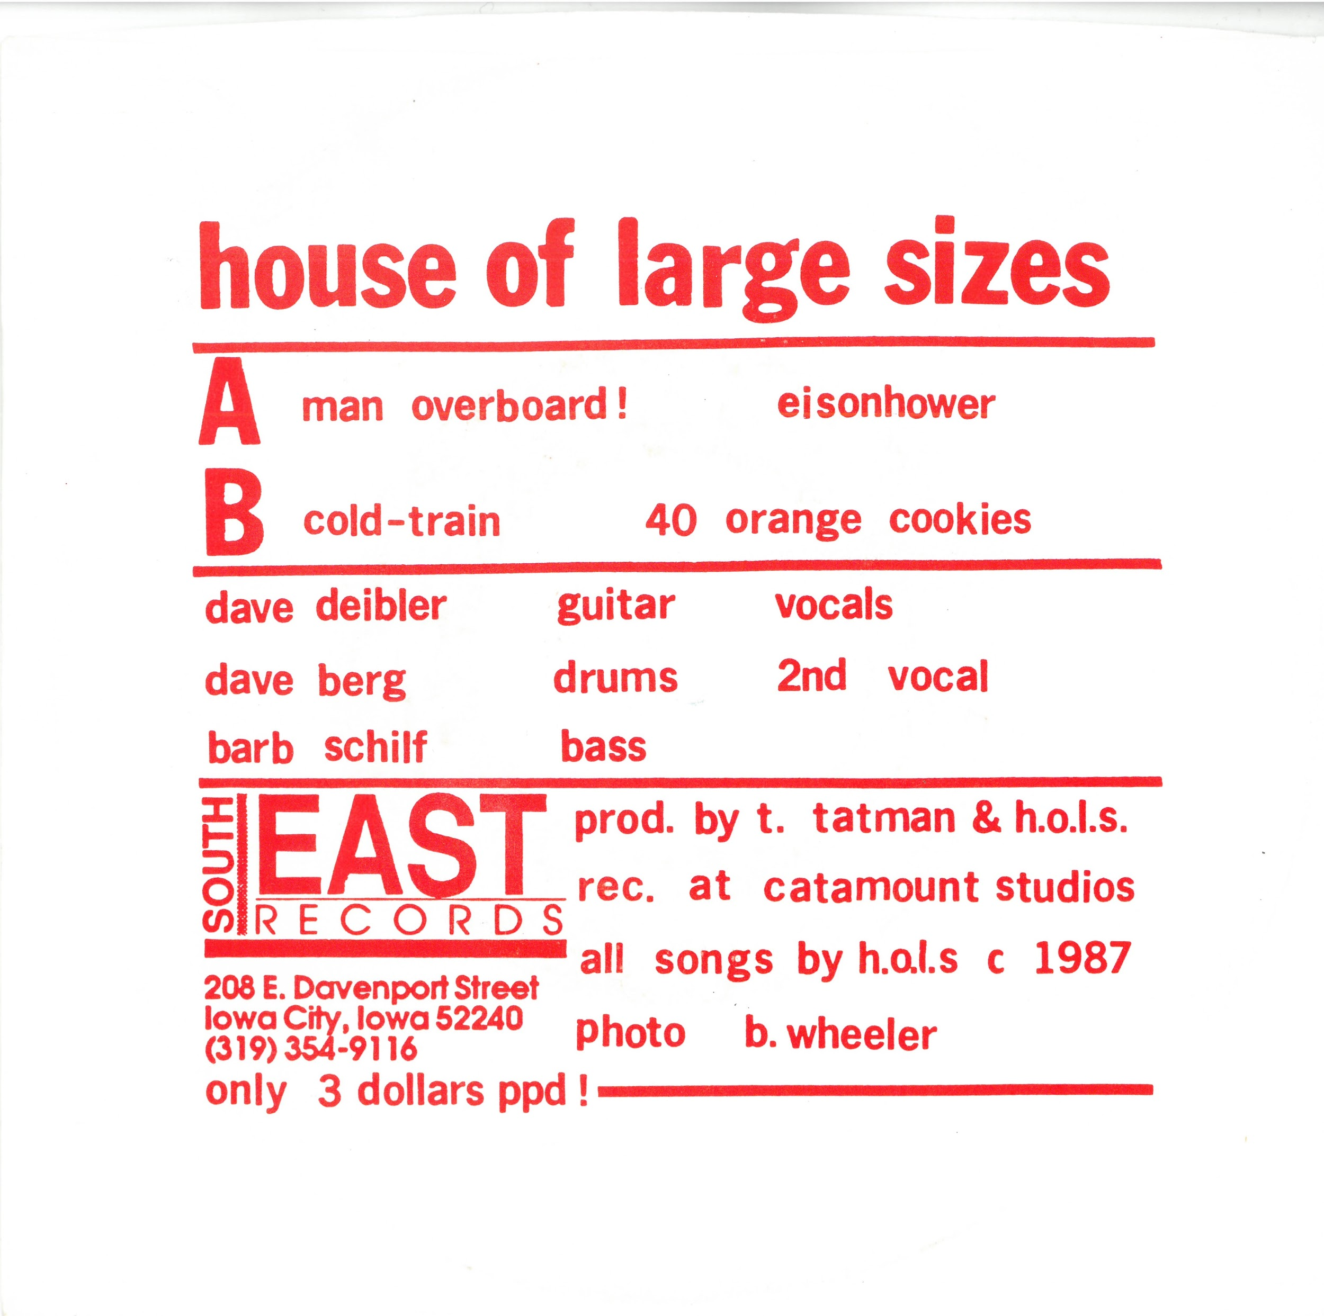
House of Large Sizes (1987)

